Slide 1
R chapter 5
5.1, 5.2 and 5.3

Slide 2
dplyr basics
Pick observations by their values (filter()).
Reorder the rows (arrange()).
Pick variables by their names (select()).
Create new variables with functions of existing variables (mutate()).
Collapse many values down to a single summary (summarise()).

Slide 3
Tidyverse functions
filter ~ subset
between
arrange ~ order
dataset[order(dataset$variable), ]

Slide 4
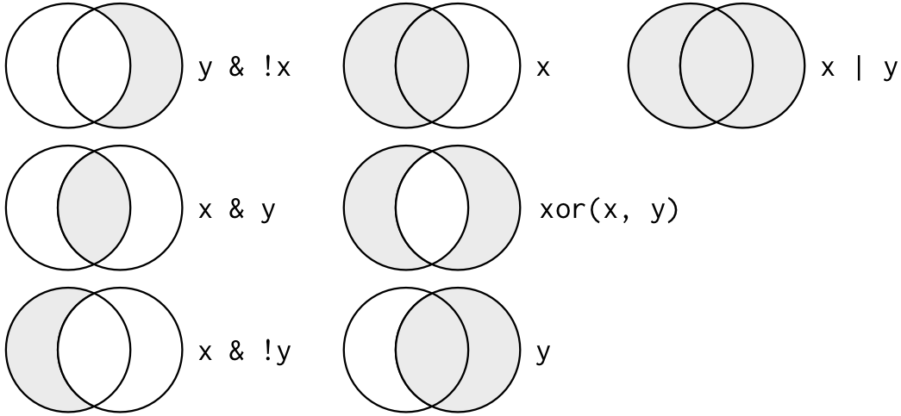
Logic

Slide 5

DeMorgans Law
!(x & y) is the same as !x | !y
!(x | y) is the same as !x & !y

Slide 6
Jupyter notebook
https://hub.gke.mybinder.org/user/binder-examples-r-29vhdwqz/notebooks/index.ipynb

